Slide 1
Contour

Slide 2
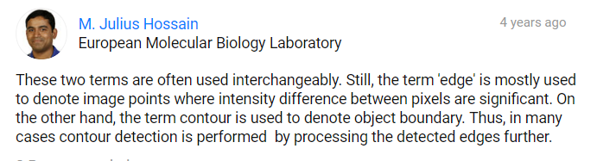
Contour와 edge
https://www.researchgate.net/post/What_is_the_difference_between_edge_and_contour

Slide 3
Contour와 edge
original
edge
contour
level0
level1
contour
Boundary of object
Need to be closed curves
Edge
Extrema of image gradient

Slide 4
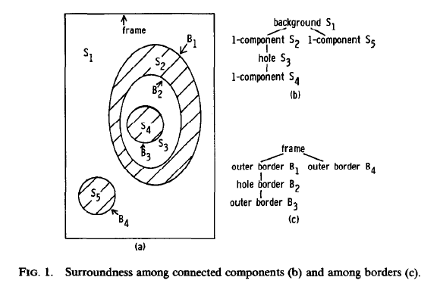
Contour detection overview
어떤 pixel들이 동일한 border를 구성하는가?
Border following / contour tracing / tracer
Border들 사이 관계?
hierarchy
COMPUTER VISION, GRAPHICS, AND IMAGE PROCESSING N,32-46 (1985)

Slide 5
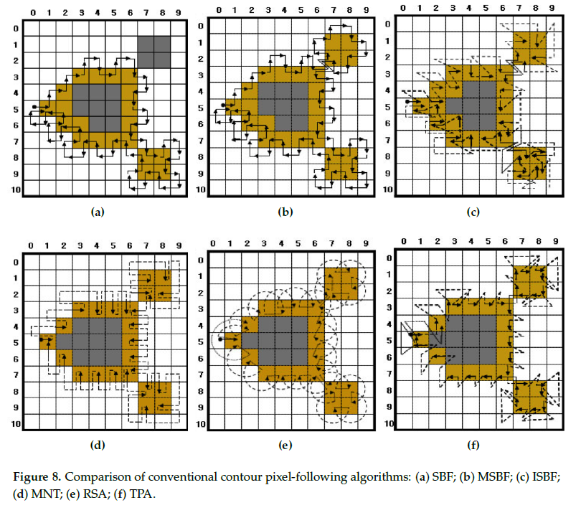
Contour tracing
Fast Contour-Tracing Algorithm Based on a Pixel-Following Method for Image Sensors

Slide 6
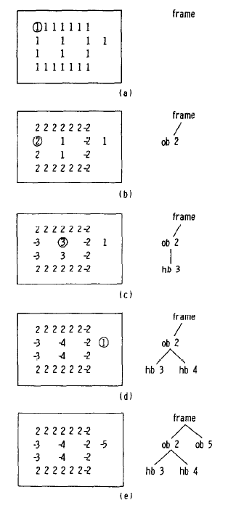
Contour detection algorithm in opencv
Border 사이 reletion 얻는 방법에 대해.
Border following은 다른 논문.
Suzuki, S. and Abe, K., Topological Structural Analysis of Digitized Binary Images by Border Following. CVGIP 30 1, pp 32-46 (1985)

Slide 7
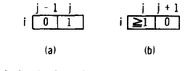
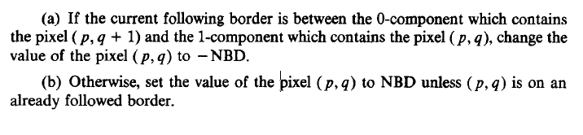
rules
Ratster scan
Meet starting point of border
Starting point of outer/hole border
If both satisfies, considered as outer border
3. Marking the pixels on the border
The border following scheme is the classical one [l-3];

Slide 8
rules
Raster scan, border 찾음
Ratster scan
Meet starting point of border
Starting point of outer/hole border
If both satisfies, considered as outer border
3. Marking the pixels on the border
오른쪽이 0, 해당 pixel이 1 -> -NBD
이외의 경우 -> NBD
이미 한번 지나간 경우 : 안바꿈
Marking, raster scan, border 찾음

Slide 9
rules
Marking, border 찾음
Ratster scan
Meet starting point of border
Starting point of outer/hole border
If both satisfies, considered as outer border
3. Marking the pixels on the border
오른쪽이 0, 해당 pixel이 1 -> -NBD
이외의 경우 -> NBD
이미 한번 지나간 경우 : 안바꿈

Slide 10
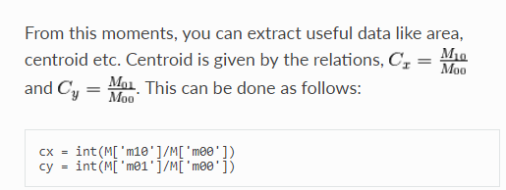
Contour 찾는 방법 /
Contour 표시 방법
Contour feature
Moment ( center of mass)
Area
Perimeter ( arc length)
Approximation (implementation of douglas-peucker algorithm)
Convex hull
Convexity
Bounding rectangle
Minimum enclosing circle
Fitting and ellipse
Fitting a line

Slide 11
Contour properties
Aspect ratio
Extent
Solidity
Equivalent diameter
Mask and pixel points
Extreme points
More functions
Convexity defect
Point polygon test
Match shapes
hierarchy

Slide 12
findContour
drawContour
Hierarchy
Approximation (implementation of douglas-peucker algorithm)
Convex hull
Convexity
Bounding rectangle
Minimum enclosing circle
More functions
Convexity defect
Point polygon test
Match shapes

Slide 13
background
hole
Value = 0
Value = 1
border
border
Value = 1
Value = 1
frame

Slide 14
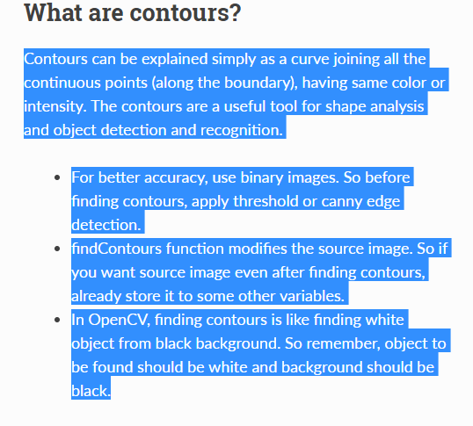

Slide 15
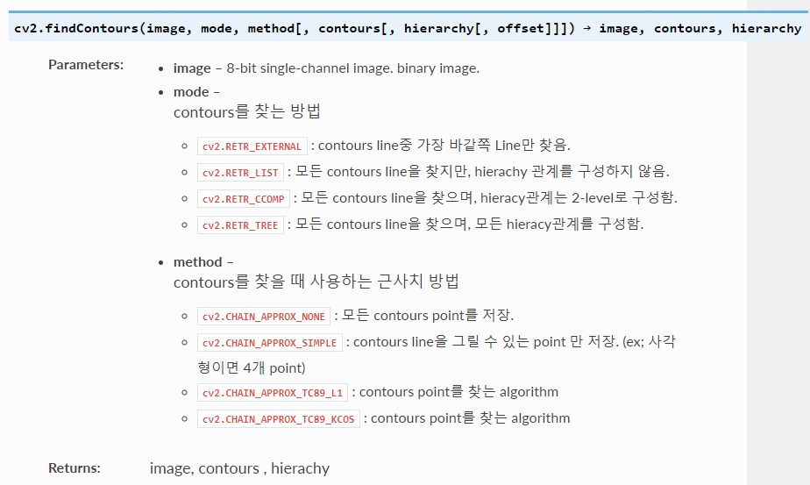
cv2.findContours(image, mode, method[, contours[, hierarchy[, offset]]]) → iamage, contours, hierarchy

Slide 16
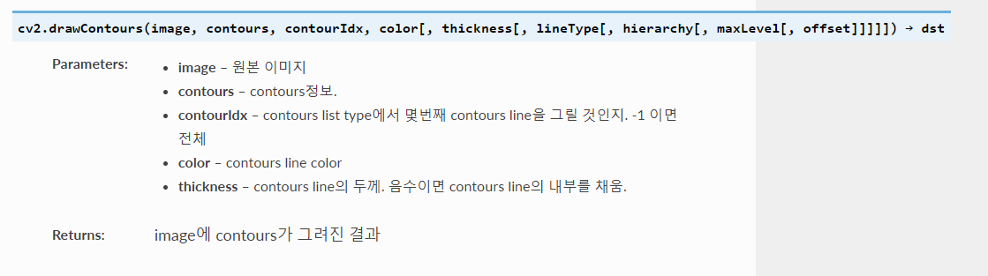

Slide 17
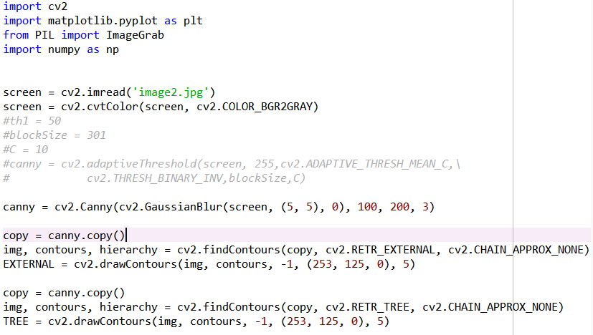

Slide 18
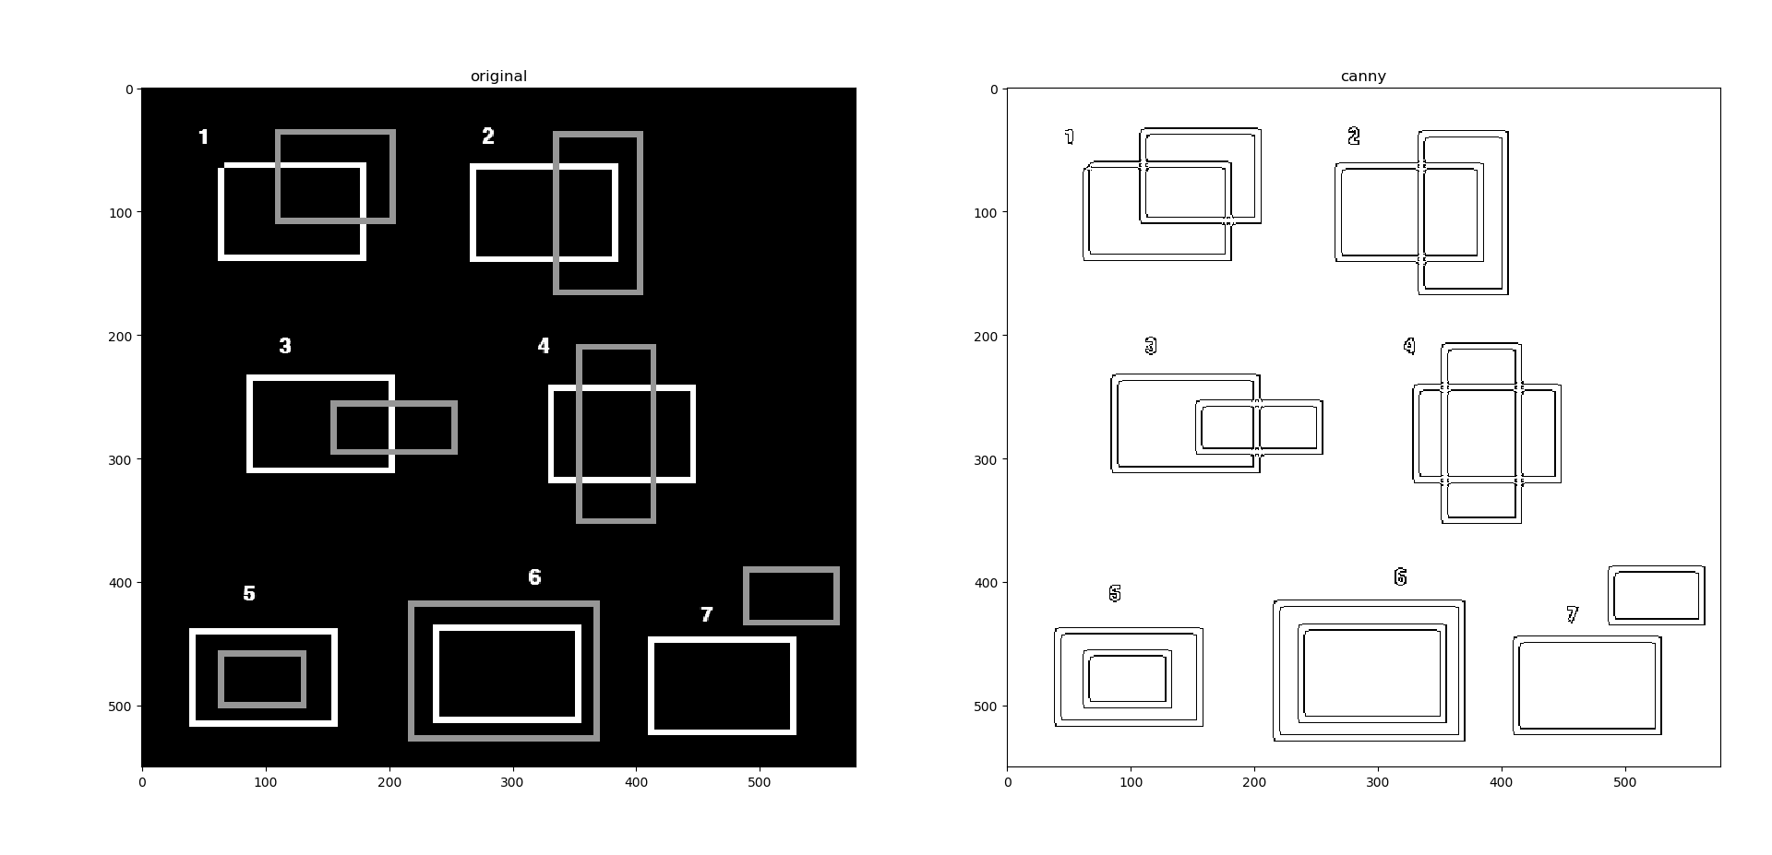
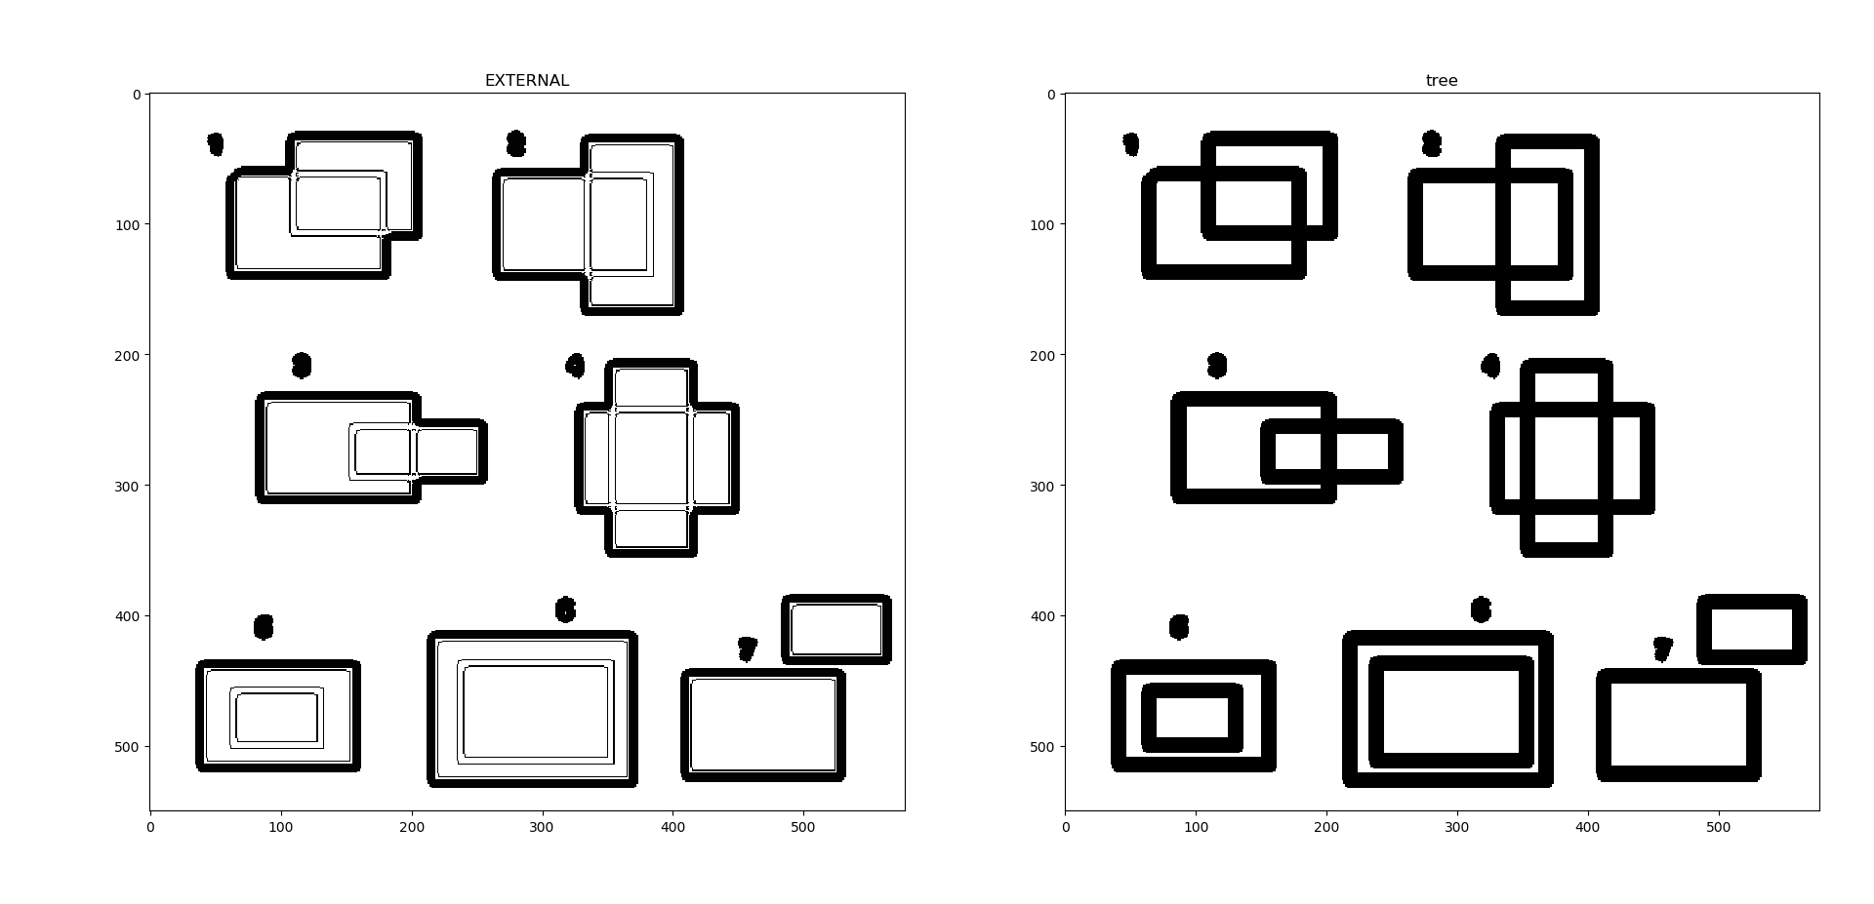
Original
Canny
s
EXTERNAL
TREE

Slide 19
